Slide 1
Email in the Workplace
By Dipali Murti, M.B.A., M.F.A.
FACULTy, UCSB WRITING PROGRAM

Slide 2
Today’s Workshop
The Role of Email in the Workplace
When to Send an Email
Email Etiquette
Planning Your Email Message
Writing Your Email Message
Revising Your Email Message
Final Practice

Slide 3
Role of email in the workplace
Email has mostly replaced memos and in some cases letters
Role is continuing to evolve
Use is organization/culture-specific
6% of GenZers use email in their private lives
Slack and other types of collaborative software are increasing in popularity
6.3 hours a day spent on checking, reading, and responding to emails
Sometimes a conversation is better!
https://www.forbes.com/sites/ciocentral/2017/02/15/as-workplace-communication-evolves-email-may-not-prevail/#763f1613626c

Slide 4
When should I send an EMAIL?
Good for shorter message such as:
Brief informative messages (policy changes, HR information, upcoming events etc.)
Simple requests with likely positive outcome
Shorter persuasive messages
Routine or minor negative news
Good news

Slide 5
When should I send an EMAIL?
Avoid for:
Longer messages of any type with lots of data, visual aids and evidence.
Can be used as a “cover note” to send a report or proposal
Longer requests that require more persuasiveness
Sensitive information (check with your organization for protocol)
Negative news around finances, sensitive HR messaging and any other that may be difficult for recipient

Slide 6
Email Tips
Use a professional email address
Use professional salutations
Include a signature block
Practice good grammar
Resist emojis in email
Use exclamation points sparingly
Be cautious with humor
Know that people from different cultures speak and write differently
Proofread every message
Call out attachments

Slide 7
EmaiL Tips
Add the email address last
Select recipients carefully
Think twice before hitting 'reply all’
Double-check that you've selected the correct recipient
Always use standard fonts and formatting
Keep tabs on your tone
Nothing is confidential — so write accordingly
Respond in a timely manner
Set informative out-of-office replies

Slide 8
Creating effective emails

Slide 9
WRItiNG PROCESS
PLANNING
WRITING
REVISING

Slide 10
PLAN YOUR MESSAGE
What is your objective?
What specific goal do you have?
What outcome do you want?
Who is your audience?
What do they know?
What do they need to know?
What is their likely reaction?

Slide 11
PLAN YOUR MESSAGE
What kind of information do I need to include?
How long do I anticipate this message will be?
What is the best way to send this message ➡️ Email?

Slide 12
What is EMAIL FORMAT?

Slide 13
Plan Your Message
What is the best way to organize this message?
Direct Method better for cases in which the likely reaction is neutral to positive
Indirect Method can be used for shorter persuasive messages in which the likely reaction is skeptical or resistant
May consider other formats if resistance anticipated is high

Slide 14
DIRECT METHOD MESSAGE STRUCTURE
Use for informational, routine and good news messages

Slide 15
DIRECT METHOD MESSAGE STRUCTURE
INTRO
Set the context and give the point of the message in the first paragraph.
What is this message about?
Express appreciation for the recipient
MIDDLE PARAGRAPHS
Give the relevant details in the middle paragraphs of the message
Give the details in a logical and objective way
Should anticipate audience needs
FRIENDLY CLOSE
Always end on a friendly note, expressing appreciation and looking to the the future

Slide 16
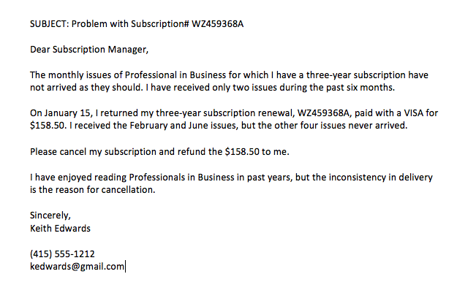

Slide 17
INDIRECT AIDA METHOD STRUCTURE
Use for shorter persuasive messages
Think back to your objective and the audience’s likely reaction
AIDA STRUCTURE (Attention, Interest, Desire, Action)

Slide 18
INDIRECT AIDA METHOD STRUCTURE
INTRO
Give context, but don’t state the point. Be optimistic and positive
Attract attention (A) by relating to audience interests
MIDDLE PARAGRAPHS
Create interest (I) by building on attention gained in the intro
Stress benefits to the receiver
Motivate them to keep reading
Build desire (D) by providing proof of benefits.
Anticipate and overcome their objections
FRIENDLY CLOSE
End on a friendly note that makes the request for action (A).
Make the action easy and motivate a timely response.

Slide 19
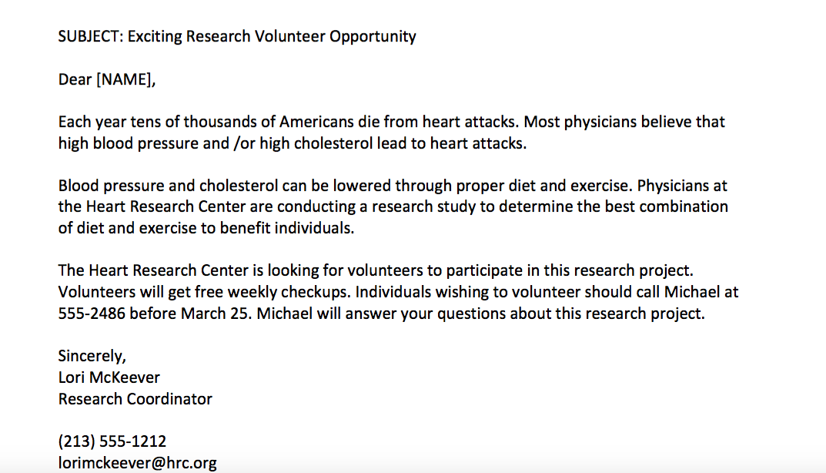

Slide 20
WRITE YOUR MESSAGE
Use the “you” attitude
Consider your audiences interests and needs
Use “you” more than “we”
Speak in terms that they can relate to

Slide 21
reflect the “you” attitude
Your email order cannot be processed; we request that you use the order form on our website instead.
To ensure the accuracy of your order, please use this link to place your order through our website.
We insist that you always bring your credit card to the store.
For your protection, please bring your credit card with you.
We want to get rid of all of our 2018 model monitors to make room in our warehouse for the new 2019 model monitors. Thus we are offering a 25 percent discount on all sales this week.
All monitors are 25% off this week!

Slide 22
WRITE YOUR MESSAGE
Choose your email salutation carefully
Keep it professional “Dear” “Hi” ”Hello”
Use appropriate titles “Dr.” vs. ”Ms.” or ”Mr.”
If they have a Doctorate degree. ➢ Use Dr.
If they don’t, then use Mr. or Ms.
Don’t move to a more informal version of their name unless they direct you to do so.
Use business format for the text
Flush left, 12pt font, single-spaced with a space between paragraphs
Consider using headers to break up the text

Slide 23
Write your message
Make your subject heading stand out!
EXAMPLES
A Question
vs.
A Question regarding the Aug 12th meeting
Sales
vs.
Oct 2019 Sales Report

Slide 24
Write your message
Use simple accessible vocabulary unless the topic is more academic
Utilize vs. Use
Keep language courteous and positive
Challenge vs. Problem
Avoid using cliché’s and confusing jargon
Avoid biased language or inappropriate humor
Try to keep the message as brief as possible. Give the details necessary, but don’t make them scroll and scroll. Message in initial window is the goal.

Slide 25
Keep the language positive
To avoid the loss of your credit rating, please remit payment within 10 days.
To protect your credit rating, please remit payment within 10 days.
We don’t make refunds on returned merchandise that is soiled.
We issue refunds on unused merchandise only.
Because we are temporarily out of Baby Cry dolls, we won’t be able to ship your order for 10 days.
Due to high demand, your Baby Cry doll will be shipped in 10 days.

Slide 26
REVISING YOUR MESSAGE
Check your content
Check your organization
Check your language
Check your style and tone
Check your format
PROOFREAD!

Slide 27
How can you improve this?

Slide 28
REVISED EXAMPLE

Slide 29
How can you improve this?

Slide 30
REVISED EXAMPLE

Slide 31
Your TURN!
The move to our new offices will take place over this coming weekend. For everything to run smooth, everyone will have to clean out their own desk and pack up the contents in boxes that will be provided. You will need to take everything off the walls, too, and please pack it along with the boxes.
If you have a lot of personal belongings, you should bring them home with you. Likewise with anything valuable. I do not mean to infer that items will be stolen, irregardless it is better to be safe than sorry.
On Monday, we will be unpacking, putting things away, and then get back to work. The least amount of disruption is anticipated by us, if everyone does their part. Hopefully, there will be no negative affects on production schedules, and current deadlines will be met.

Slide 32
IMPROVE IT!
OBJECTIVE
What is the purpose of the message? What is the larger goal?
AUDIENCE
Who is the audience? What is their knowledge of this topic? What is their interest in the topic? What is their likely response?
GATHERING INFORMATION
What information do they need?
What are the main points of this email?
ORGANIZATION
Which organizational method should you use?
WRITING
How is the language choice?
How is the tone?
How is the grammar and spelling?
How would you rewrite this to make it more effective?

